Slide 1

Data Structures (15B11CI311) Odd Semester 2021
3rd Semester , Computer Science and Engineering
Jaypee Institute Of Information Technology (JIIT), Noida

Slide 2
Lecture: 22
Topics to be covered:
Introduction to k-ary tree
Operations on k-ary Tree

Slide 3
k-ary Tree
A tree in which every node has at most K children is known as an K-ary tree
If K=2 then it will be a binary tree
If K=3 then it will be a ternary trees, and so on
The examples with k>2: 2-3 tree, B-tree
All the children of a node in a K-ary tree are sequentially ordered, i.e. left-to-right

Slide 4
Example of k-ary Tree with k=4

Slide 5
Properties of k-ary Tree
The maximum depth of a K-ary tree, having N nodes: N
The minimum depth of a K-ary tree, having N leaves: log_{k} (N+1)

Slide 6
k-ary Search Tree
An K-ary search tree is a K-ary tree in which
A set of K-1 key values is stored at each node
All key values in a sub-tree Sn, lie between the key values Vn and Vn+1 of the parent node.
A binary search tree is an example of an K-ary search tree, where K is 2.
http://www2.cs.uregina.ca/~beattieb/CS340/notes/09%20-%20Non-Binary%20Trees.pdf

Slide 7
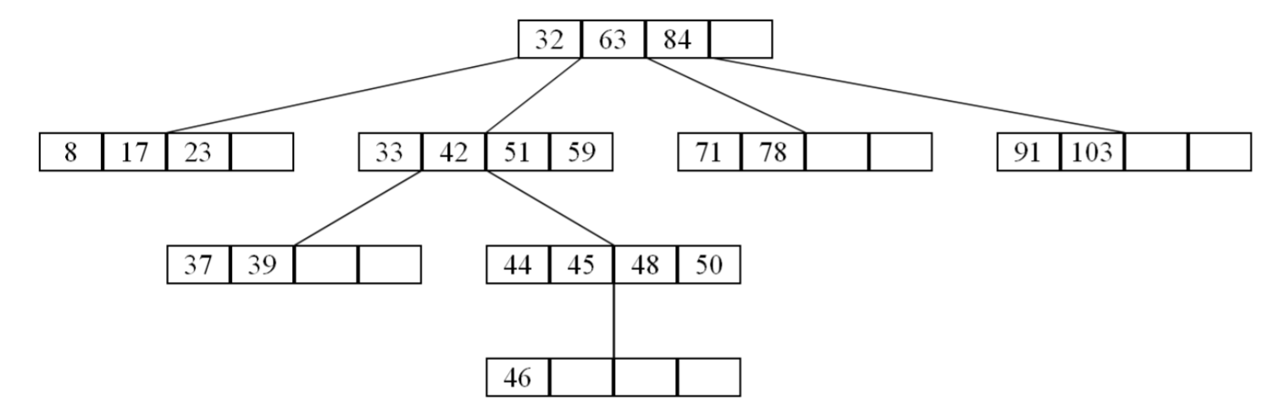
Example of k-ary Search Tree with k=5
http://www2.cs.uregina.ca/~beattieb/CS340/notes/09%20-%20Non-Binary%20Trees.pdf

Slide 8
Traversal in k-ary Tree
Traversing a k-ary tree is very similar to binary tree traversal.
Pre-order traversal: visit parent, left subtree and then right subtree
Post-order traversal: left subtree, right subtree, and then visit parent
In-order traversal: left subtree, visit parent and then right subtree
However, as there are more than two children per node for m > 2, left and right subtrees are to be defined
One possible approach is to divide the list of children nodes into two groups:
First (m-1) can be considered as part of left subtree and m^{th} node as right subtree or vice-versa or
The first m/2 nodes as the left subtree and rest m/2 nodes as the right subtree

Slide 9
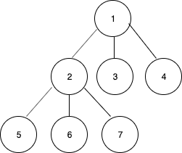
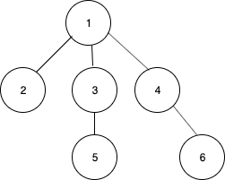
Inorder traversal of k-ary Tree (k=3)
Output: 5 6 2 7 3 1 4
Output: 2 5 3 1 4 6
Approach: First (m-1) can be considered as part of left subtree and m^{th} node as right subtree
Source: https://www.geeksforgeeks.org/inorder-traversal-of-an-n-ary-tree/

Slide 10
Inorder Traversal of k-ary tree (k=3)
#include<iostream>
using namespace std;
class Node {
public:
int data;
Node *children[3];
Node(int val)
{
data = val;
}
};
void inorder(Node *node) {
if (node == NULL)
return;
for (int i = 0; i < 2; i++)
inorder(node->children[i]);
cout<< node->data << " ";
inorder(node->children[2]);
}
int main() {
Node* root = new Node(1);
root->children[0] = new Node(2);
root->children[1] = new Node(3);
root->children[2] = new Node(4);
root->children[0]->children[0] = new Node(5);
root->children[0]->children[1] = new Node(6);
root->children[0]->children[2] = new Node(7);
inorder(root);
return 0;
}

Slide 11
Preorder traversal of k-ary Tree (k=3)
Output: 1 2 5 6 7 3 4
Output: 1 2 3 5 4 6
Approach: First (m-1) can be considered as part of left subtree and m^{th} node as right subtree
Source: https://www.geeksforgeeks.org/inorder-traversal-of-an-n-ary-tree/

Slide 12
Preorder Traversal of k-ary tree (k=3)
void preorder(Node *node)
{
if (node == NULL)
return;
cout<< node->data << " ";
for (int i = 0; i < 2; i++)
preorder(node->children[i]);
preorder(node->children[2]);
}

Slide 13
Postorder traversal of k-ary Tree (k=3)
Output: 5 6 7 2 3 4 1
Output: 2 5 3 6 4 1
Approach: First (m-1) can be considered as part of left subtree and m^{th} node as right subtree
Source: https://www.geeksforgeeks.org/inorder-traversal-of-an-n-ary-tree/

Slide 14
Postorder Traversal of k-ary tree (k=3)
void postorder(Node *node)
{
if (node == NULL)
return;
for (int i = 0; i < 2; i++)
postorder(node->children[i]);
postorder(node->children[2]);
cout<< node->data << " ";
}

Slide 15
References
Cormen, Thomas H.; Leiserson, Charles E.; Rivest, Ronald L.; Stein, Clifford (2009) [1990]
Introduction to Algorithms (3rd ed.). MIT Press and McGraw-Hill. ISBN 0-262-03384-4. 1320 pp.
Adam Drozdek, Data Structures and Algorithms in C++ (2nd Edition), 2001
https://www.geeksforgeeks.org/inorder-traversal-of-an-n-ary-tree/
http://www2.cs.uregina.ca/~beattieb/CS340/notes/09%20-%20Non-Binary%20Trees.pdf

